Slide 1
Authentication servers

Slide 2
Authentication servers are designed to provide centralized authentication services to users throughout an organization so that user accounts can be managed in one place, rather than on hundreds or thousands of individual computers. This allows enterprises to streamline account provisioning and audit tasks
Forensic Value Authentication servers typically log successful and/or failed login attempts and other related events. Investigators can analyze authentication logs to identify bruteforce password-guessing attacks, account logins at suspicious hours or unusual locations, or unexpected privileged logins, which may indicate questionable activities.

Slide 3
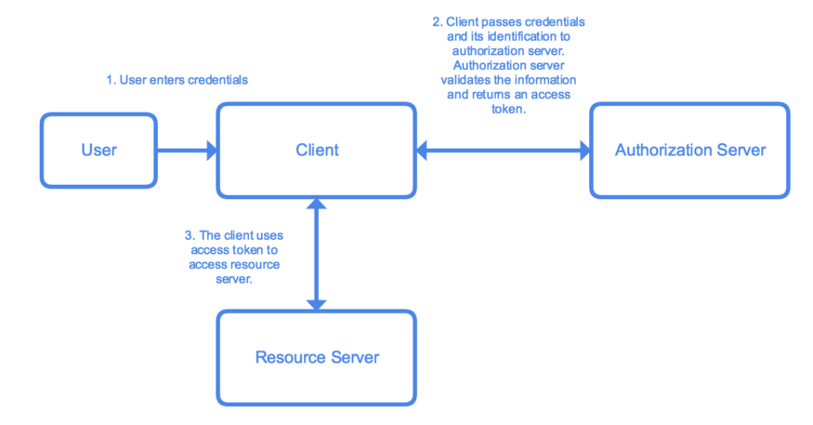
Authentication is the process of determining whether someone or something is actually who or what it declares itself to be.

Slide 4
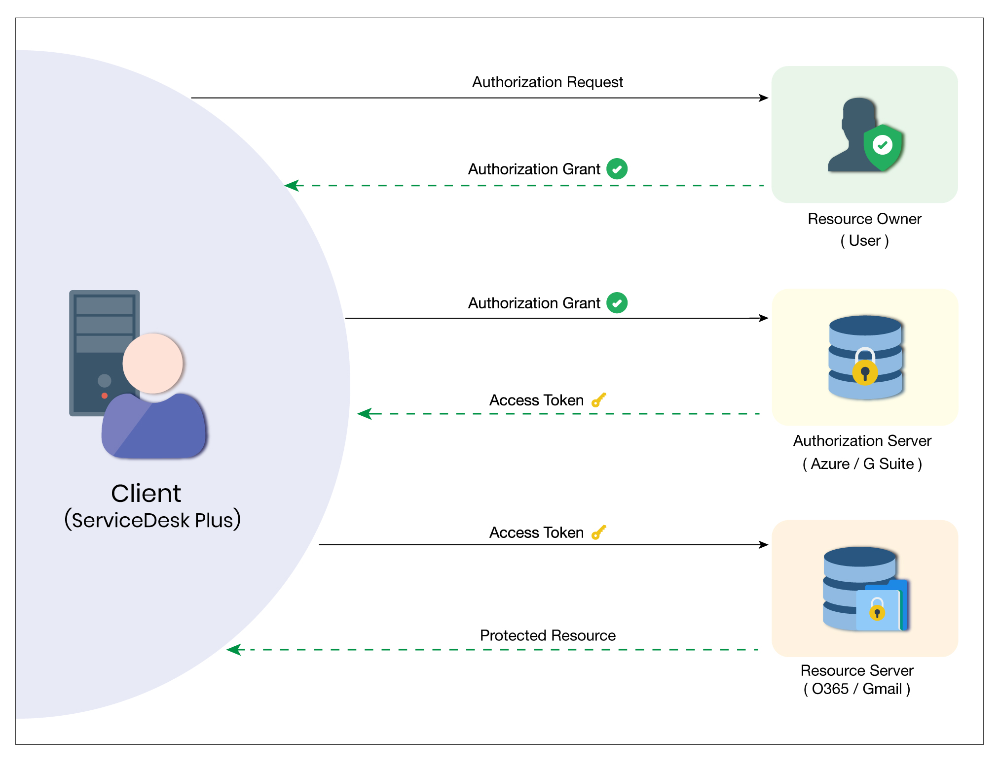

Slide 5
Firebox Authentication
AuthPoint Authentication
RADIUS Server Authentication
VASCO Server Authentication
SecurID Authentication
LDAP Authentication
Active Directory Authentication

